Slide 1

Robotic-Assisted Surgery
Kenny Miller

Slide 2
Lecture Plan
History of Surgeries
Minimally Invasive Surgeries
Robotic-Assisted Surgeries (RAS) and examples
Main RAS System
Benefits of RAS

Slide 3
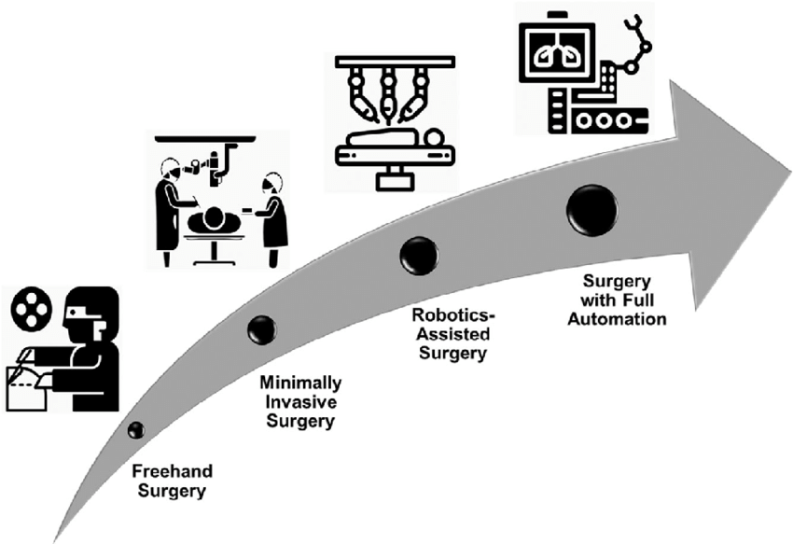
Surgical History
1840s
surgical anesthesia first demonstrated
1896
first successful heart surgery
1950s
first successful organ transplants
1985
first robotic surgery performed
2000
da Vinci surgical system receives FDA approval

Slide 4
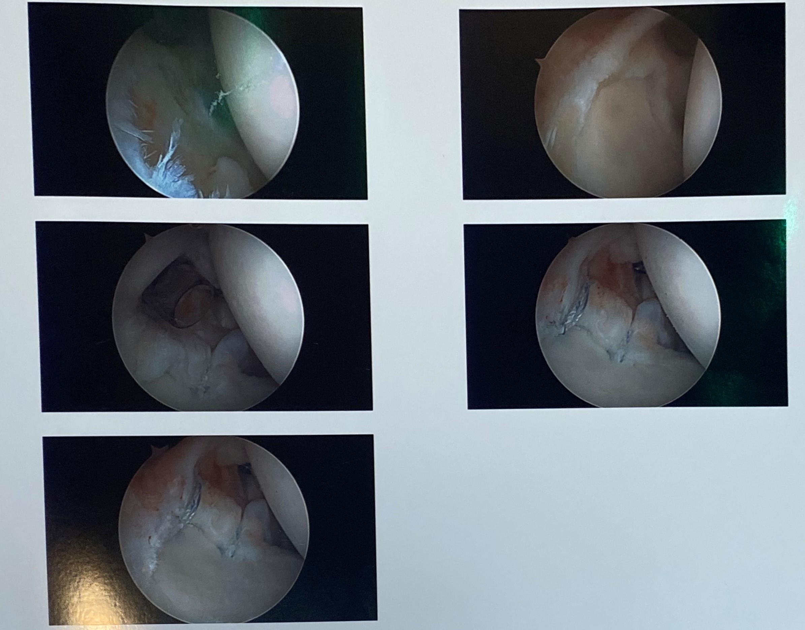
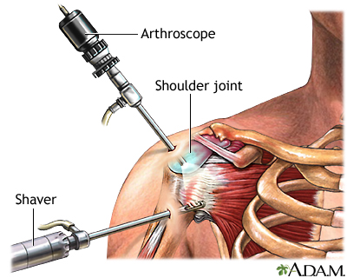
Minimally Invasive Surgeries
Main non-robotic types
Endoscopic: utilized to treat internal organs
Arthroscopic: utilized to treat joints
Small incisions
Short hospital stays
Less pain

Slide 5
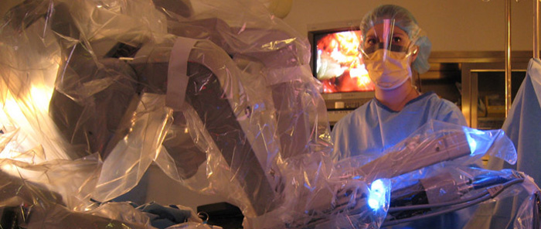
Robotic-Assisted Surgery (RSA)
A version of minimally invasive surgery
Surgeon makes small incisions in your body and inserts miniaturized instruments and a high-definition 3D camera
Surgeon is in control the entire time; robot is not performing any surgery
Surgeon operates robot from a nearby console (think like a video game)

Slide 6
Robotic-Assisted TKA
Two studies (2013 and 2020) showed robotic-assisted TKA (rs-TKA) appears to reduce the number of mechanical axis outliers when compared to a conventional TKA (c-TKA)
2013 study:
100 patients (split 50/50) with minimum followup time of 41 months
“Robotic-assisted TKA appears to reduce the number of mechanical axis alignment outliers and improve the ability to achieve flexion-extension gap balance, without any differences in clinical scores or complications when compared to conventional manual techniques”
2020 study:
60 patients (split 50/50) with pre and post-operative measurements taken
“robotic system for TKA is highly accurate with respect to component positioning in coronal plane and mechanical alignment as compared to conventional TKA. Joint line is elevated in conventional TKA but is accurately restored using the robotic-assisted TKA which may lead to better patellofemoral kinematics”
2013: https://dx-doi-org.utk.idm.oclc.org/10.1007%2Fs11999-012-2407-3
2020: https://doi-org.utk.idm.oclc.org/10.1007/s00167-020-06353-2
Notes:
ROM, WOMAC, and HSS (hospital for special surgery) scores showed no difference between c-TKA and rs-TKA (2013)

Slide 7
Robotic-Assisted TKA Cont.
Robotic-Assisted TKA to help with Coronal Correction (2018 study)
“this study demonstrated that all knees were corrected in the appropriate direction within a few degrees of neutral, and no knees were overcorrected”
“the results from this study demonstrate the potential for the robotic-assisted device during TKA in helping surgeons achieve a preoperatively planned desired neutral alignment”
https://www.thieme-connect.com/products/ejournals/abstract/10.1055/s-0037-1608840
Notes:
330 rb TKAs performed by a single surgeon to assess if the correction of varus/valgus deformities is more consistent/successful with than conventional TKA
Deformities were considered severe if there were 7 degrees or more away from neutral (non-severe if less)
In more severe cases not all patients were corrected to neutral but they were within a couple of degrees of neutral

Slide 8
da Vinci Surgical Systems
Approved by the FDA for surgical use in multiple procedures
First system approved and utilized by surgeons

Slide 9
da Vinci Surgical Systems Cont.
Consists of:
Surgeon’s Console
Four robotic arms
Video tower
Enhance surgeon’s capabilities:
Magnified view (10x what the human eye sees) of the operating area
Tiny instruments of the system move like the human hand
Built in tremor-filtration system helps move each instrument with smooth percision

Slide 10
da Vinci Surgical Systems Cont.
Approved for several types of surgery:
Cardiac Surgery
Colorectal Surgery
General Surgery (hernia, gallbladder, bariatric)
Gynecology Surgery
Head and Neck Surgery
Thoracic (Chest) Surgery
Urology Surgery

Slide 11
Benefits of RSA
Patient
Lower risk of infection
Smaller incisions and Less scarring
Less loss of blood
Quicker recovery times
Surgeon/Hospital
Can carry out more complex tasks
Greater dexterity and accuracy
Camera stability
Elimination of tremors
Better patient outcomes (more visits/center of excellence)

Slide 12

Questions

Slide 13
References
https://www.uclahealth.org/robotic-surgery/what-is-robotic-surgery
https://www.mayoclinic.org/tests-procedures/robotic-surgery/about/pac-20394974
https://www.davincisurgery.com/
https://doi.org/10.1371/journal.pone.0016395
https://www.hopkinsmedicine.org/minimally_invasive_robotic_surgery/types.html
https://mountainview-hospital.com/about/newsroom/the-evolution-of-surgery

